Slide 1
Session 1
RDBMS Concepts

Slide 2
Session Objectives
Explain the concept of data and database.
Describe the approaches to Data Management.
Define a Database Management System and list its benefits.
Explain the different database models.
Define and explain RDBMS.
Describe entities and tables and list the characteristics of tables.
List the differences between a DBMS and RDBMS.

Slide 3
Data and Database
Data means information and it is the most important component in any work that is done.
A database is a collection of data.
Thus, a database is a collection of data that is organized such that its contents can be easily accessed, managed, and updated.
Stores Information
Database
Users
Allows to Access Information

Slide 4

Data Management
Data management deals with managing large amount of information, which involves both the storage of information and the provision of mechanisms for the manipulation of information.
The two different approaches of managing data are:
  File-based systems
  Database systems

Slide 5

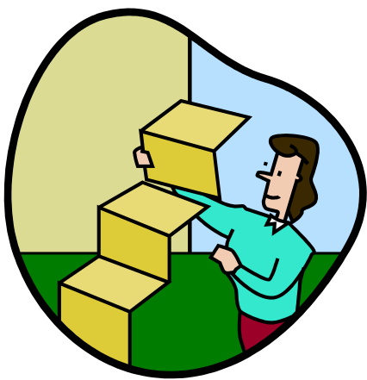
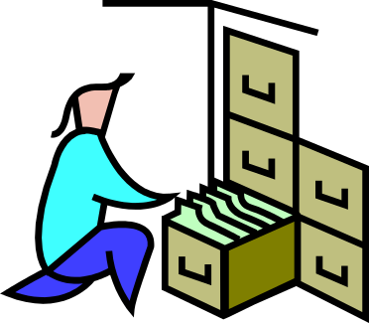
File-based systems 1-3
Features of file-based systems:
Systems in which data was stored
in discrete files.
In this system, a bunch of files was stored on a computer and could be accessed by a computer operator.

Slide 6

File-based systems 2-3
Example
The Sales database will contain the following tables:
  PropertyForRent (PropertyNo, Address, Type, Rent, OwnerNo)
  PrivateOwner (OwnerNo, Name, Address, TelNo)
  Client (ClientNo, Name, Address, TelNo, PrefType, MaxRent)
Sales
Database
Data entry and reports
File handling routines

Slide 7
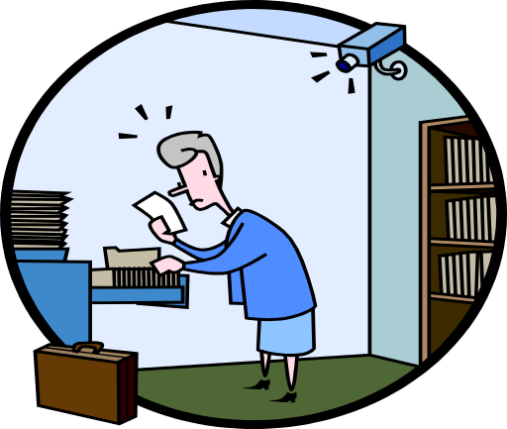

File-based systems 3-3
Disadvantages of File-based Systems are:
  Data Redundancy and Inconsistency
  Unanticipated Queries
  Data Isolation
  Concurrent Access Anomalies
  Security Problems
  Integrity Problems

Slide 8
Database systems
Databases are used to store data in an efficient and organized manner, which allows quick and easy management of data.
Advantages of database systems are:
  The amount of redundancy in the stored data can be reduced
  No more inconsistencies in data
  The stored data can be shared
  Standards can be set and followed
  Data Integrity can be maintained
  Security of data can be implemented

Slide 9
Database Management System (DBMS) 1-2
It is a collection of related records and a set of programs that access and manipulate these records.
DBMS provides an environment that is both convenient and efficient to use when there is a large volume of data and many transactions to be processed.
It enables the users to define, create, and maintain the database and provides controlled access to this database.
Different DBMS support different query languages, although there is a semi-standardized query language called SQL (Structured Query Language).

Slide 10
Database Management System (DBMS) 2-2
Data entry and
reports
Database
DBMS
Data entry and
reports

Slide 11
Benefits of DBMS
The benefits of typical DBMS are as follows:
  Data Storage
  Data Definition
  Data Manipulation
  Data Security and Integrity
  Data Recovery and Concurrency
  Performance
  Database Access Languages and Application Programming Interfaces

Slide 12
Database Models 1-5
Databases can be differentiated based on functions and model of the data.
A data model describes a container for storing data, and the process of storing and retrieving data from that container.

Slide 13



Database Models 2-5
- Hierarchical model
- Network model
- Relational model

Slide 14

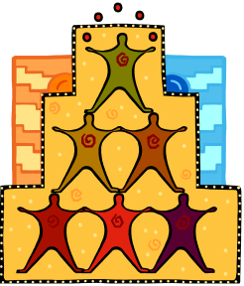

Database Models 3-5
The different types of data models are:
  Flat-file Data model
    This model is used for simple databases. The database consists of only one table or file.
  Hierarchical Model
    Records are inter-related through hierarchical or tree-like structures.
    In this model, relationships are thought of in terms of children and parents. A parent record can have several children, but a child can have only one parent.

Slide 15
Database Models 4-5
  Network Data Model
    It is similar to the Hierarchical Data Model.
    The hierarchical model is actually a subset of the network model.
    The network model uses set theory to provide a tree-like hierarchy with the exception that child tables were allowed to have more than one parent.
    Data is stored in sets, instead of the hierarchical tree format. This solves the problem of data redundancy.

Slide 16
Database Models 5-5
  Relational Data Model:
In the Relational Model, there are no physical links. All data
is maintained in the form of tables consisting of rows and
columns.
Data in two tables is related through common columns.
Operators are provided for operating on rows in tables.
This model represents the database as a collection of
relations. In this model’s terminology, a row is called a
tuple, a column an attribute and the table is called a
relation. The list of values applicable to a particular field is
called domain.

Slide 17
Relational Database Management System (RDBMS)
A Relational Database Management System (RDBMS) is a database management system where all data visible to the user is organized strictly as tables of data values, and where all database operations take place on these tables.
A relational database is a database divided into logical units called tables, where tables are related to one another within the database.
Relationship
TABLE 1
Key
Data...
TABLE 2
Key
Data...
Database

Slide 18
Terms related to RDBMS
Term | Meaning
Relation | A table
Tuple | A row or a record in a relation
Attribute | A field or a column in a relation
Cardinality of a relation | The number of tuples in a relation
Degree of a relation | The number of attributes in a relation
Domain of an attribute | The set of all values that can be taken by the attribute
Primary Key of a relation | An attribute or a combination of attributes that uniquely defines each tuple in a relation
Foreign Key | An attribute or a combination of attributes in one relation R1, which indicates the relationship of R1 with another relation R2 The foreign key attributes in R1 must contain values matching with those of the values in R2
These terms are mostly used in RDBMS:
  Data is presented as a collection of relations.
  Each relation is depicted as a table.
  Columns are attributes.
  Rows (“tuples”) represent entities.
  Every table has a set of attributes that are taken together as a “key” (technically, a “superkey”), which uniquely identifies each entity.

Slide 19
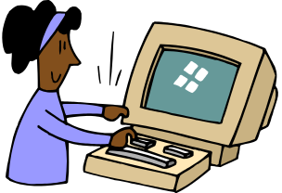
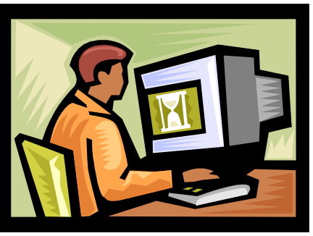
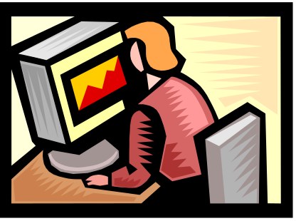
RDBMS Users
Many users are involved in the design, use, and maintenance of a large database:
  Database Administrator (DBA)
  Database Designer
  System Analysts and
  Application Programmers
  DBMS Designers and Implementers
  End User

Slide 20
Entities and Tables
An entity is a person, place, thing, object, event, or even a concept, which can be distinctly identified.
Each entity has certain characteristics known as attributes and each entity set is given a name.
A table contains a group of related entities called an entity set.
The terms entity set and table are often used interchangeably. A table is also called a relation, rows are known as tuples and columns are known as attributes.
Table
Attributes
EMPLOYEE
Emp_No | Emp_Name | Emp_DOB | Emp_DOJ
345 | James | 24-Sep-1968 | 30-May-1990
873 | Pamela | 27-Jul-1970 | 19-Nov-1993
693 | Allan | 10-Sep-1970 | 01-Jul-1992
305 | Geoff | 12-Feb-1973 | 29-Oct-1996
Tuple

Slide 21
Difference between DBMS and RDBMS
DBMS | RDBMS
It doest not need to have data in a tabular structure nor does it enforce tabular relationships between data items. | In RDBMS, tabular structure is a must and table relationships are enforced by the system. These relationships enable the user to apply and manage business rules with minimal coding.
Small amount of data can be stored and retrieved. | RDBMS can store and retrieve large amount of data.
DBMS is less secure than RDBMS. | DBMS is less secure than RDBMS.
It is a single user system. | It is a multiuser system.
Most DBMSs do not supporting client/server architecture. | It supports client/server architecture.

Slide 22
Summary
A database is a collection of related data stored in the form of a table.
The flat file system proved to be very time consuming. It had limitations of data redundancy, poor data control, and inability to easily manipulate data.
A Database Management System can be defined as a collection of related records and a set of programs that access and manipulate these records.
A data model describes a container for storing data and the process of storing and retrieving data from that container.
DBMS is a collection of programs that enables the user to store, modify, and extract information from a database.
A Relational Database Management System (RDBMS) is a suite of software programs for creating, maintaining, modifying, and manipulating a relational database.
A relational database is divided into logical units called tables. These logical units are interrelated to each other within the database.

